Slide 1

Multiple Classes
A Simple Class based Game

Slide 2


Learning Objectives
So far, implemented (and used) a single class at a time
Designing & Implementing multiple classes
Reference types
Null
Garbage collection
Class:motorbike
members
x
y
speedX
methods
void render()
void move()
boolean finished()

Slide 3
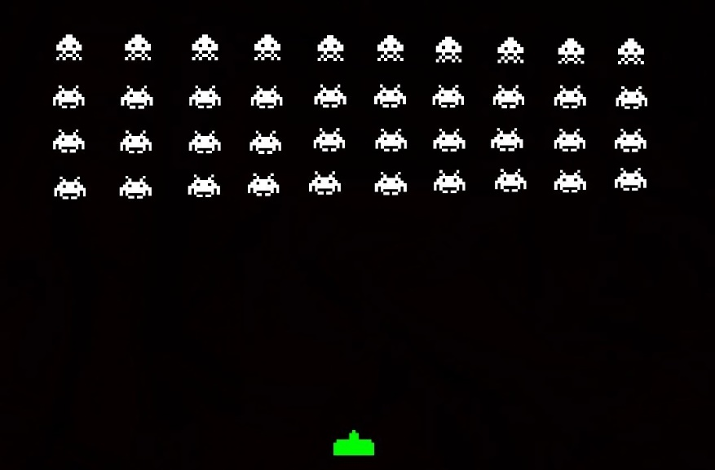
Multiple Classes
Our programs can contain as many classes as we need.
Define new classes with different names
Exercise : Space Invaderz
What information would we need for the Defender and each bullet?
Write a Defender class.
Write a Bullet class.
move: up
move:
side to side
Notes:
Walk through adding code as we go – simple graphics – ellipses and rects for now

Slide 4
Defender
Members
What collection of variables does it require?
How many subcompartments in a Defender class?
2. Constructor – what information does it need to get started?
3. Methods – what should it be able to do?
Test it!!

Slide 5
Bullet
Members
What collection of variables does it require?
How many subcompartments in a Bullet class?
2. Constructor – what information does it need to get started?
3. Methods – what should it be able to do?
Test it!!

Slide 6
(setup/draw) Top down design
Invaderz
Left, right
Across screen
Create a defender
Go left :keypress
Go right : keypress
Fire bullet :keypress
Create a new bullet
draw - event
Draw defender
If a bullet is on screen{
move bullet
draw bullet
if bullet at top of screen
remove bullet
}
What does our game need?
Notes:
What does setup need to do?
What does draw need to do?

Slide 7
Write an Invader class
class Invader
{
int x;
int y;
int speedX=1; //moves across screen
Invader(int x, int y) //constructor(s)
void display() //or render
void move()
{
x=x+speedX;
if (x >= width) //right edge
speedX = -1;
if (x<=0) //detect left hand edge
speedX = 1;
}
}
Members?
Move : left then right
Notes:
Complete code

Slide 8

Object Collision detection
We can pass Objects as parameters, to a procedure or a class method
Parameter type is the class name, e.g.
boolean crash (Walker other)
{
//compare this.x with other.x, this.y with other.y
}
if ( walker1.crash(walker2) )
walker1
this
x:40
y:80
walker2
dx:2
dy:1
x:45
y:85
dx:-1
dy:-2
other
Notes:
Would detect a collision between two instances of the same class

Slide 9
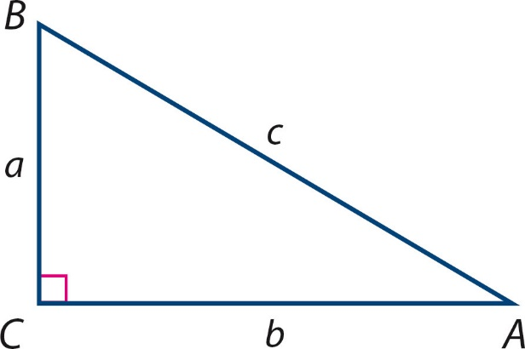
Collision – proximity detection
Collision detection can be handled by measuring the distance between two on-screen objects
Processing has a built-in Euclidean distance function : dist
E.g.
if ( dist(this.x, this.y, other.x, other.y) < 20 )
(this.x,this.y)
Pythagoras
sqrt((this.x-other.x)² + (this.y-other.y) ²)
(other.x,other.y)

Slide 10
Bullet Collision detection
Here trickier – instance of Bullet class, instance of Invader class
Could write a method from either perspective
Collision method for bullet or collision method for Invader
Should be able to remove bullet and invader from the screen
invader1
bullet
x:60
y:40
speedX: -2
x:60
y:40
speedY:-4
I’ll assume from Invader perspective

Slide 11
isShot Method
Design
If ( invader1.isShot( ) )
//do something
What type will IsShot return?
does it need any parameters passing?
If we had multiple bullets – pass the bullet we are testing
use Pythagoras (dist function)
boolean isShot(Bullet bullet)
{
if (bullet!=null)
{
if (dist(this.x,this.y,
bullet.x, bullet.y) <20)
return true;
}
return false;
}
Write an IsShot method for Invader Class

Slide 12
Using reference types
When an Invader is hit
Remove bullet and invader
Instance variables are created using the NEW keyword
Instance variables can be removed from memory by setting the variable equal to null
Garbage collection – reclaims the memory
Any memory which is no longer referenced is garbage collected
x
50
y
null
30
invader1
invader1
speedX
5.0
invader1 = null;

Slide 13
Using reference types
Similarly setting one instance variable equal to another doesn’t copy the contents!
Invader invader1, invader2;
invader1=invader2;
Invader1 and invader2 both reference the same object
Original contents of invader1 would be lost!
What effect would invader1.x=10; have?
Can only do this when the variables have the same type (e.g. Invader)
x
30
y
100
x
50
y
invader2
speedX
30
invader1
-5.0
speedX
5.0
invader1

Slide 14
Using isShot method
Can not set an object = null from a method of that object
Must check for the collision from outside the instances
E.g. From draw() event
if (invader1.isShot(bullet))
{
invader1=null; //remove invader1
bullet=null; //remove bullet
}

Slide 15
Summary
Designing and using multiple classes
Methods with parameters of an object type
Using reference types
null
garbage collection
copying objects
Notes:
Complete simple game. 1 invader, 1 bullet, 1 Defender

